Slide 1
Front End Engineering-I Project
Fitness Tracking Website
Team Details: Dev Dynamos
1. Taranjit Kaur 2410991740
2. Uday Guleria 2410991744
3. Vedanshi 2410991772
Faculty Coordinator: Dr Mandeep Singh Devgan
:
Chitkara University Institute of Engineering and Technology,
Chitkara University, Punjab

Slide 2

Introduction
Our Fitness Tracker project aims to create a user-friendly website that helps individuals stay motivated and engaged with their fitness journey. With features like a calendar for daily activity tracking and workout video demonstrations, the site makes staying fit simple and enjoyable for users at any fitness level. Our goal is to create a website that’s not just functional, but also easy and fun to use.

Slide 3
Technical Details
HTML: To structure the website layout, including sections for tracking fitness data, workout routines, and progress.
CSS: For styling and ensuring the website is visually appealing, responsive, and user-friendly.
JavaScript: To handle user input, display workout recommendations, and create dynamic elements like the calendar for tracking daily activities.
Video Embeds: For adding workout demonstrations, helping users follow proper form and technique.

Slide 4
Bonus Features
Calendar View:
Users can manage and view their fitness activities on a calendar interface, allowing for easy scheduling and tracking of workouts.
Guided Meditation and Mindfulness:
A dedicated section for guided meditation and mindfulness exercises promotes mental well-being. Users can track their meditation sessions, view progress, and receive personalized recommendations based on their stress levels.

Slide 5
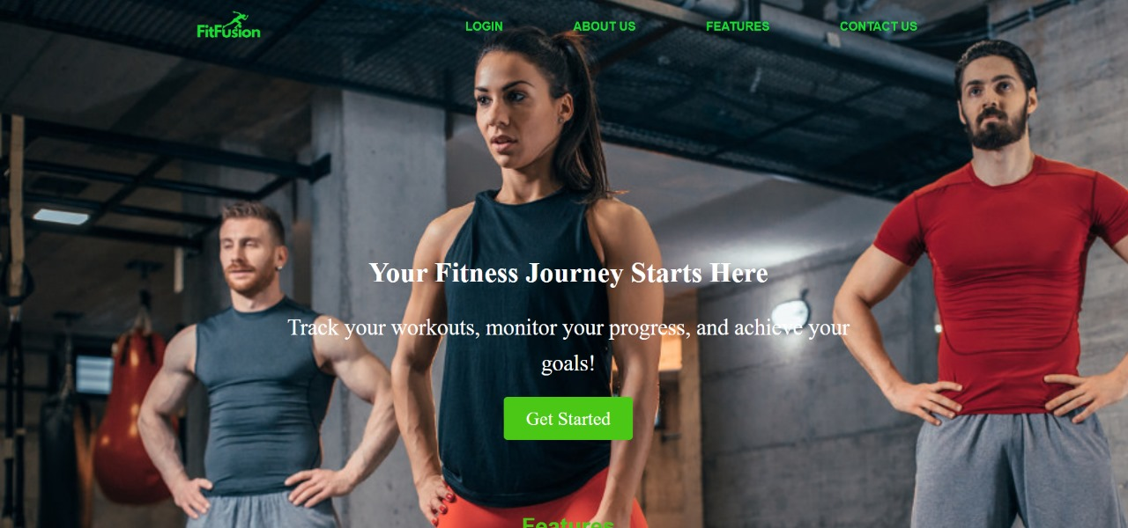
Home Page

Slide 6
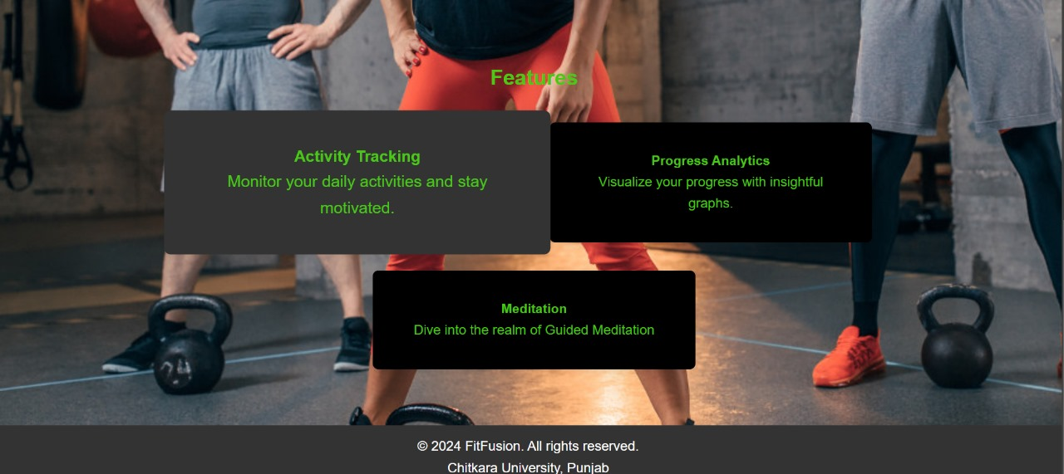
Home Page

Slide 7
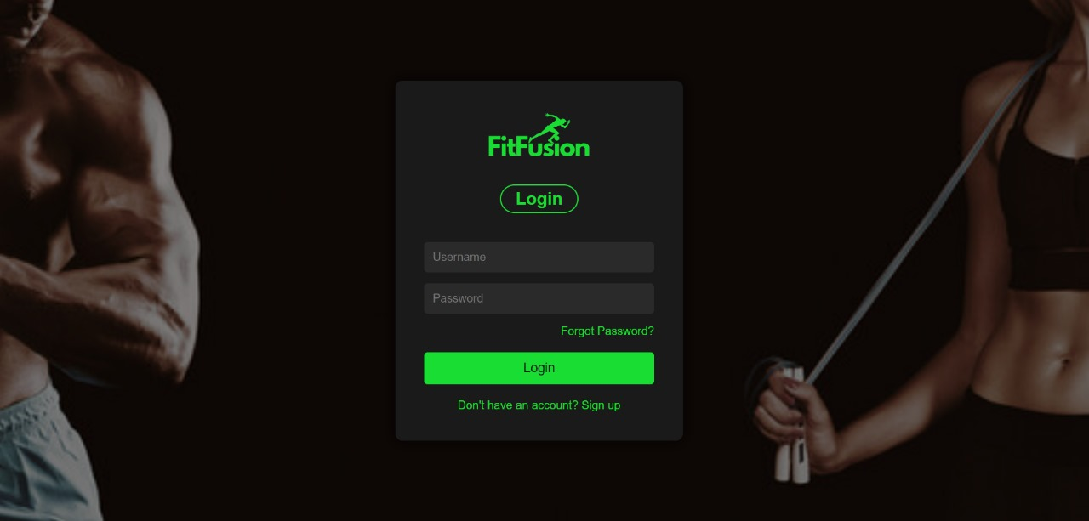
Login Page

Slide 8
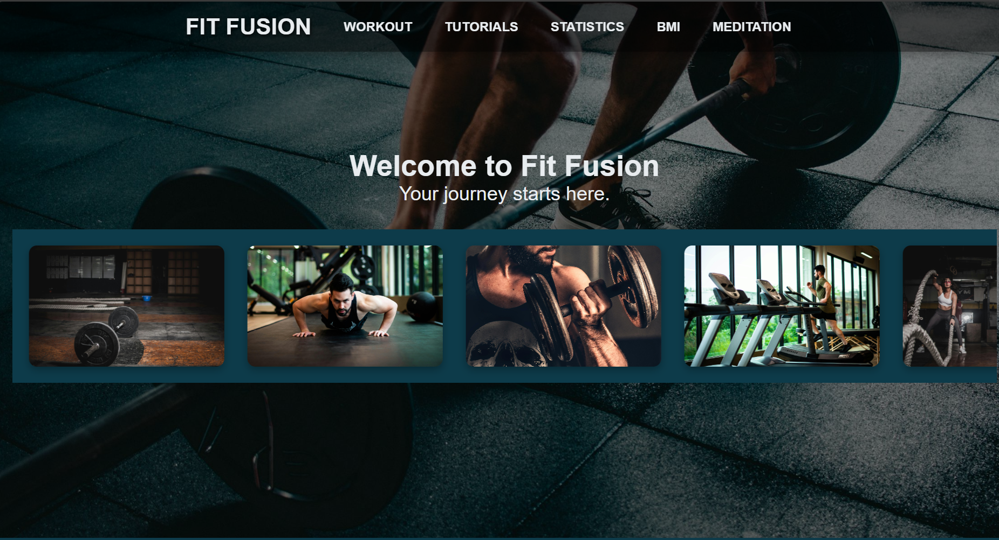
Landing Page

Slide 9
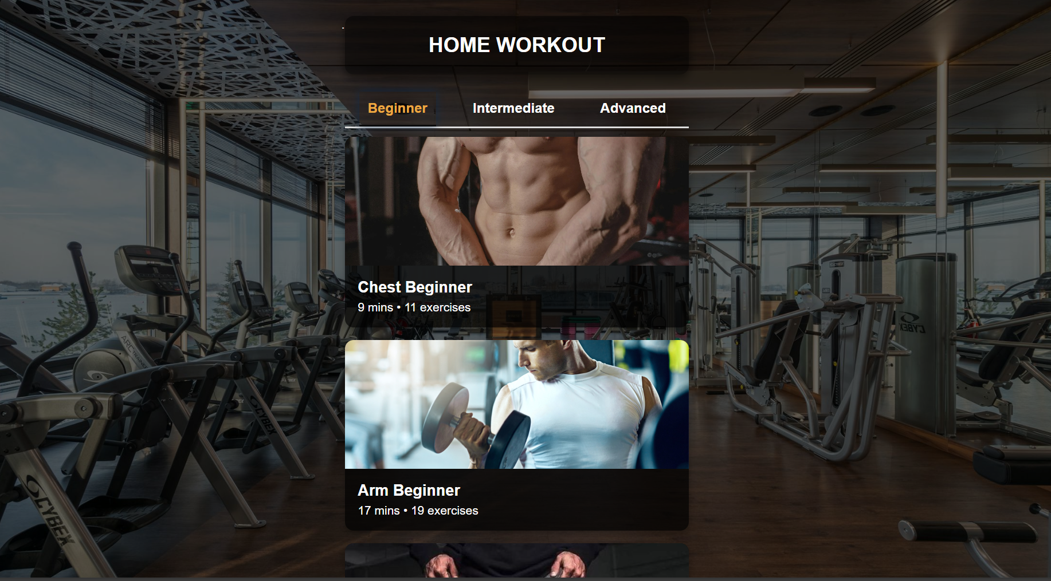
Workout

Slide 10
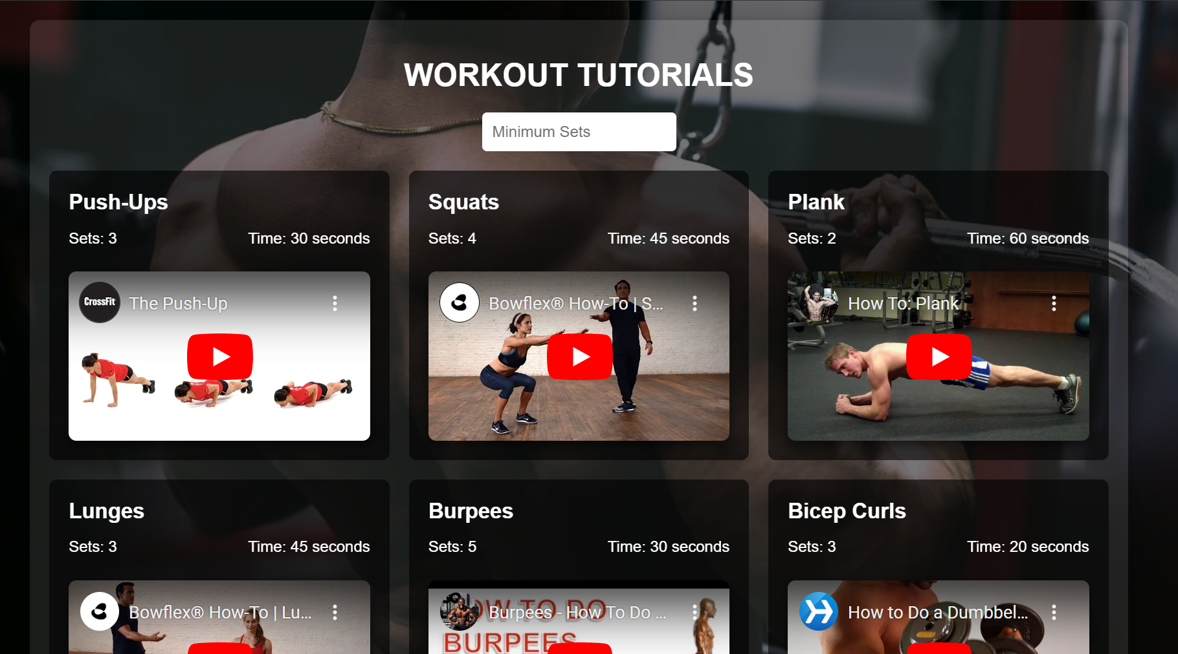
Tutorials

Slide 11
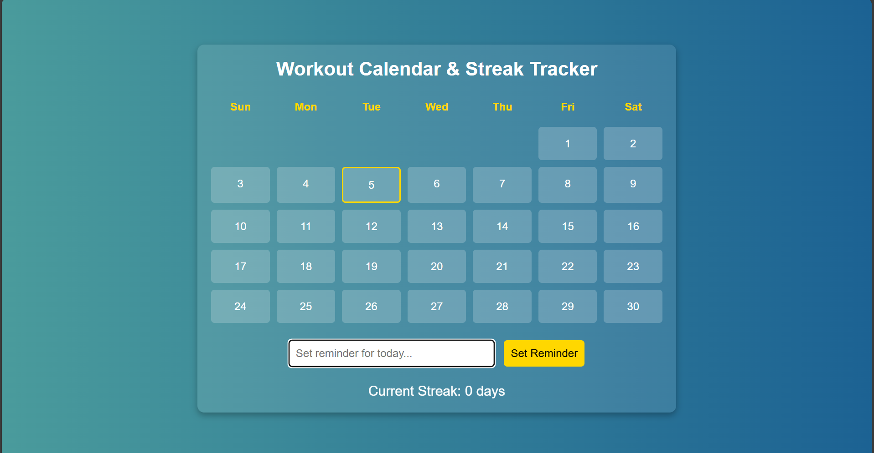
Calendar

Slide 12
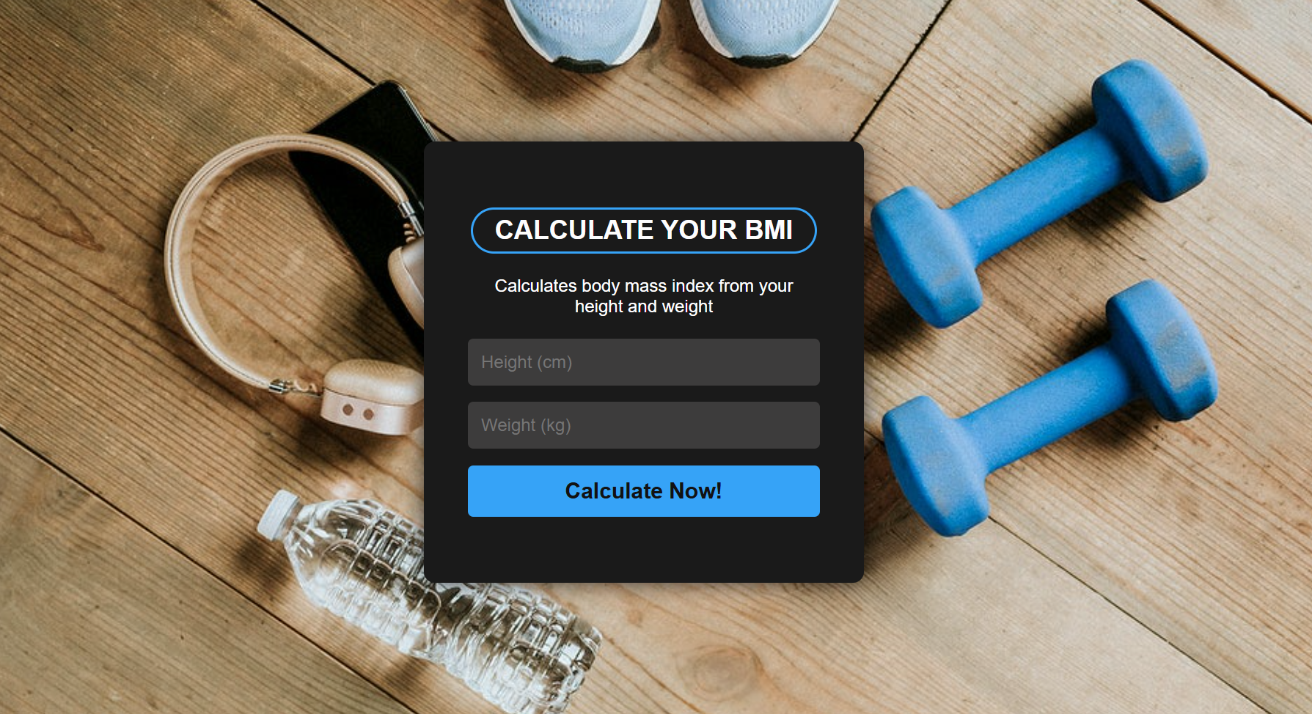
BMI Calculator

Slide 13
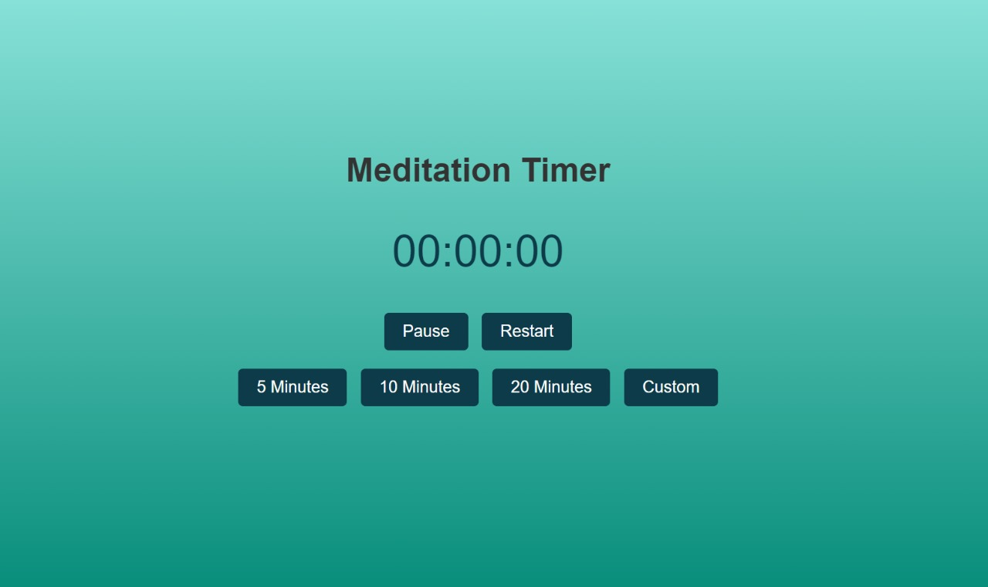
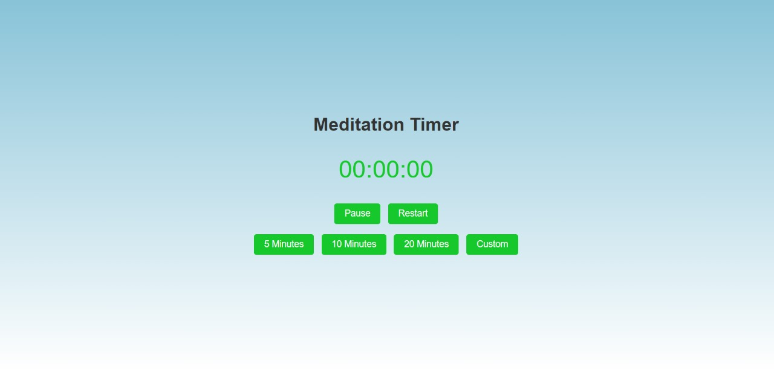
Meditation

Slide 14
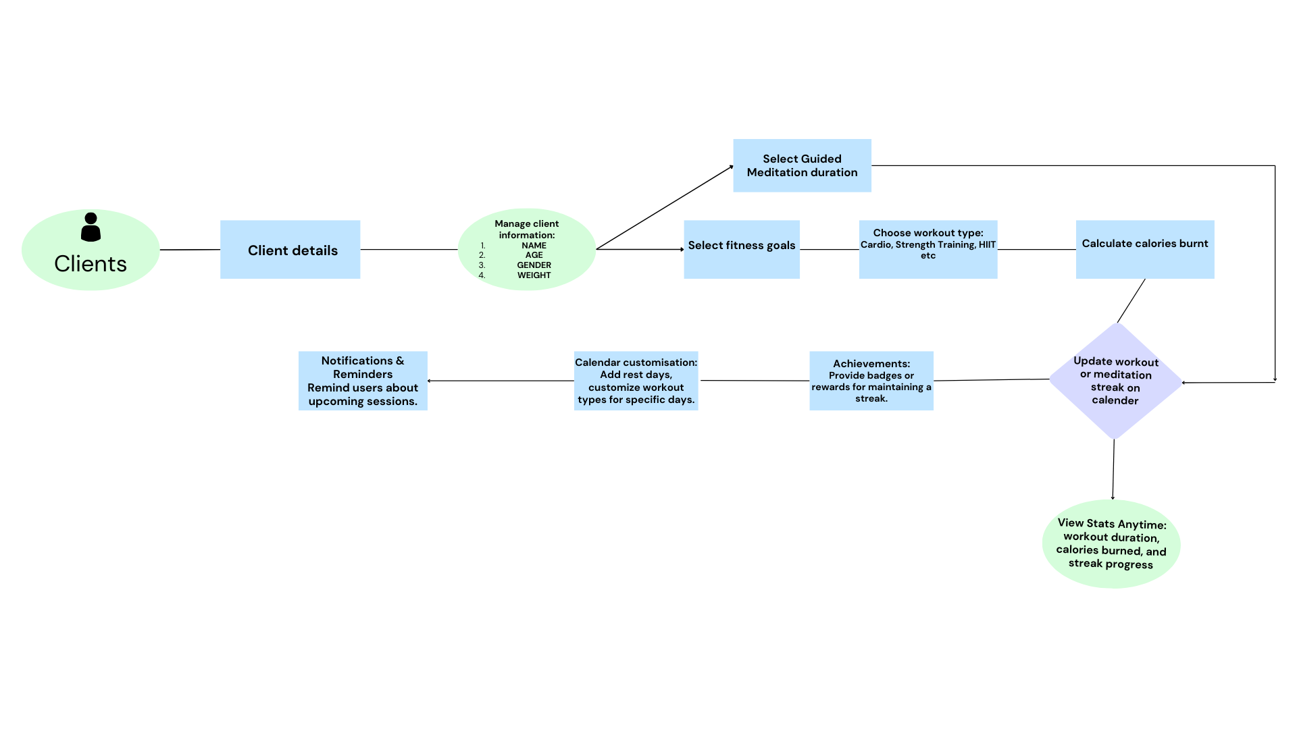
Flowchart

Slide 15


